Slide 1
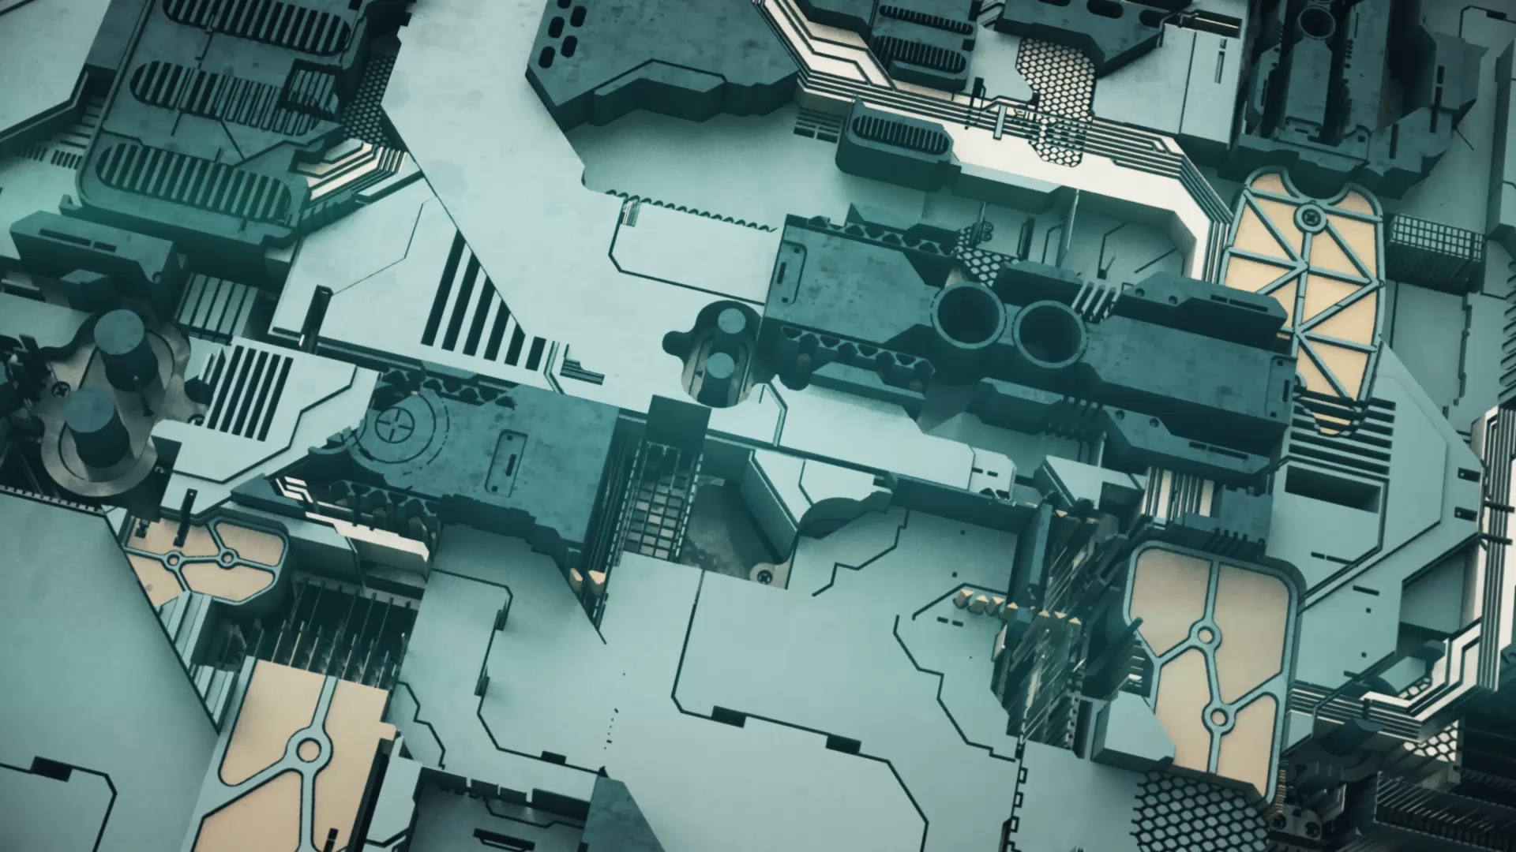
M2M Mini Project
Developers: Patrascu Matei & Batca George Leonard
Coordinators: Figaroa Owsald, Langenhuijzen Koen

Slide 2
Raspberry Pi as PLC
Raspberry pi configured as PLC
Monitoring for the robot arms
Web-camera
Control from the PLC over the Robot arms
Log system

Slide 3
CodeSys
Used as IDE for the Raspberry PI code
Apache2 webserver for streaming the video
API to trigger responses

Slide 4
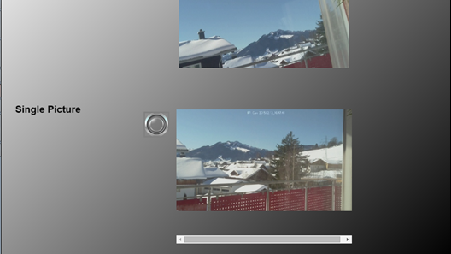

Slide 5
Next steps
Trubleshooting compatibility issues
Implement the API Triggers on press of buttons
Configure the log system for error handleling

Slide 6
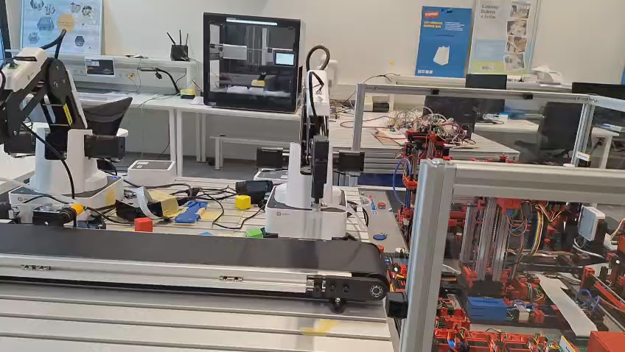

Slide 7
Reflection
Went Good | Could Go Better
Collaboration | More focus
Fast designing and implementation | Faster research
Solid plan | Planning

Slide 8
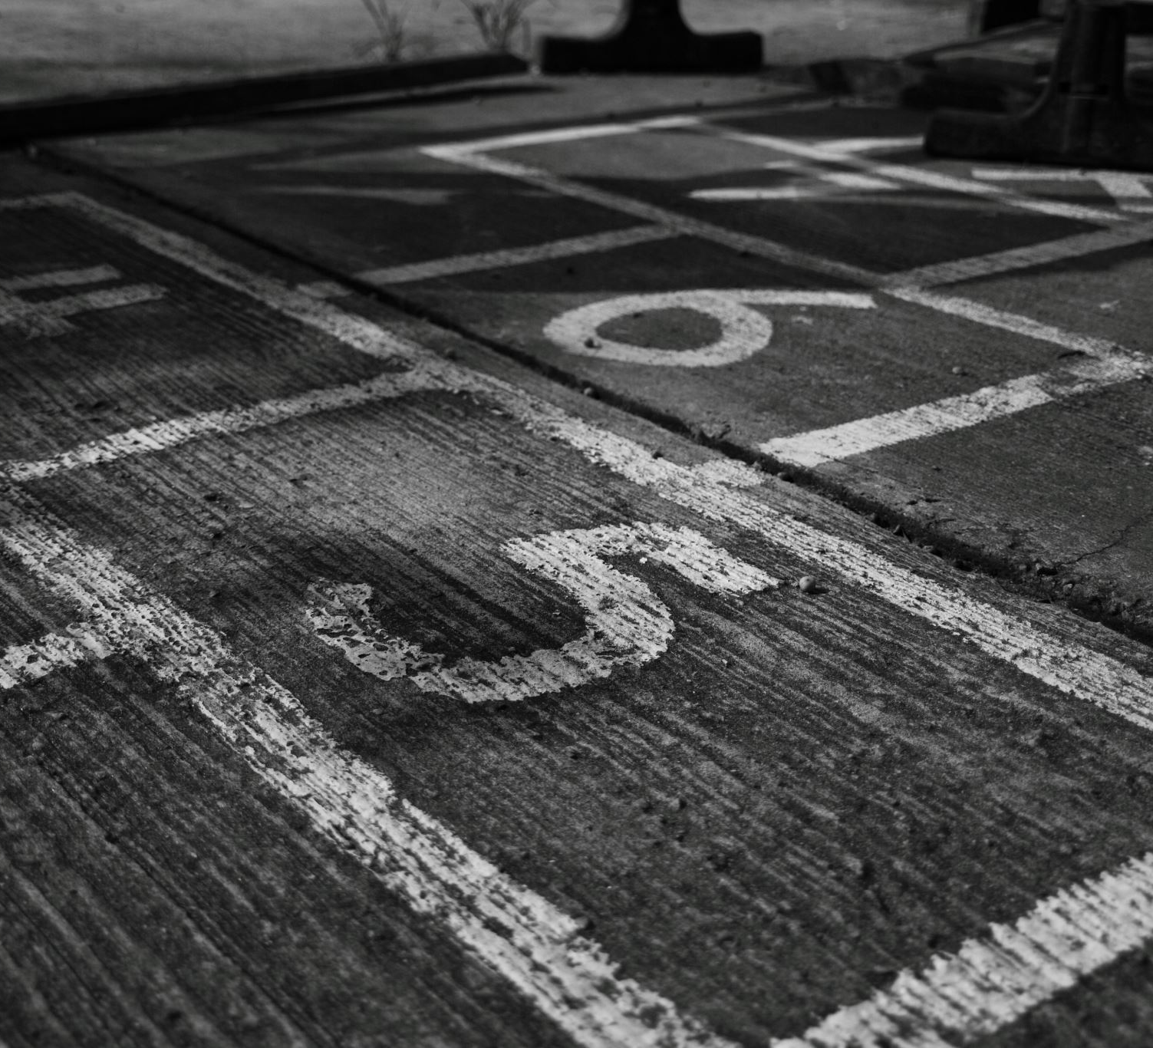
Q&A

Slide 9

Thank You!

